Slide 1
Smart Light Control With IoT

Slide 2
Content
Introduction
Objective
Hardware Required
Circuit Design
Advantages
Conclusion

Slide 3
Introduction
Introducing our ESP32-based Smart Bulb Controller project! With the integration of an ESP32 microcontroller, a Light Dependent Resistor (LDR), and a mobile app interface, this project offers both automatic and manual control functionalities for your home lighting system. The system intelligently detects ambient light levels using the LDR, automatically switching the bulb on during nighttime and off during daytime. Additionally, users can conveniently override the automatic mode and control the bulb remotely via our intuitive mobile app interface. Experience seamless automation and personalized control with our ESP32 Smart Bulb Controller!

Slide 4
Objective
The primary objective of our project is to develop a smart lighting system using ESP32 and LDR technology, enabling automatic control of a bulb based on ambient light levels. This includes designing a robust hardware setup to accurately measure light levels and control the bulb's operation. Additionally, we aim to create a user-friendly mobile app interface that allows users to manually control the bulb remotely. By achieving these objectives, we aim to provide a seamless and convenient solution for efficient home lighting automation.

Slide 5
Hardware Required
LDR Module
The Light Dependent Resistor (LDR) module is a key component in our project, serving as the sensor for detecting ambient light levels. This module consists of a photoresistor whose resistance changes based on the intensity of light falling on it. When connected to the ESP32 microcontroller, the LDR module allows us to accurately measure light levels in the surrounding environment. This information is crucial for the automatic control of the bulb, ensuring it turns on during nighttime and off during daytime.

Slide 6
2. Relay Module
The relay module is an essential component in our project, responsible for controlling the power supply to the bulb. It consists of an electromechanical switch that can be controlled by the ESP32 microcontroller. When the relay receives a signal from the microcontroller, it either connects or disconnects the circuit, effectively turning the bulb on or off. This relay module enables seamless integration between the ESP32 and the bulb, allowing us to automate its operation based on the ambient light level detected by the LDR module.

Slide 7
3. ESP32 Module
The ESP32 microcontroller is the heart of our project, providing the intelligence and connectivity required for our smart lighting system. It features a powerful dual-core processor and built-in Wi-Fi and Bluetooth capabilities, making it ideal for IoT applications. With its analog and digital input/output pins, the ESP32 enables us to interface with sensors like the LDR module and control devices like the relay module. Through programmed logic, the ESP32 processes sensor data, executes control algorithms, and communicates with the user interface, whether through the mobile app or other means. Its versatility and efficiency empower our project to deliver automated lighting control and remote access features seamlessly.

Slide 8
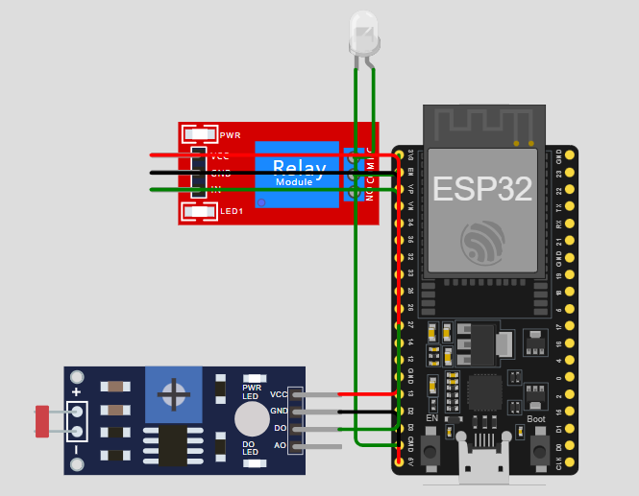
Circuit Diagram

Slide 9
Explanation
Our project is all about creating a smart lighting system that knows when to turn on and off, without needing anyone to flip a switch. We're achieving this by using an LDR sensor, which can tell us how bright it is outside. When it gets dark, the sensor tells a relay module to switch on the light bulb automatically.
Conversely, when it's bright again, the sensor communicates to the relay to turn off the bulb. But we're not stopping there; we're also adding a mobile app feature. With the app, users can control the light manually if they want to, giving them the flexibility to adjust the lighting according to their preferences, all from the convenience of their smartphone

Slide 10
Advantages
Energy Efficiency: By automatically turning the bulb on and off based on ambient light levels, the system ensures that the light is only used when necessary. This can lead to significant energy savings over time.
Convenience: Users no longer need to manually control the light switch, especially during changes in daylight. The system seamlessly adjusts the lighting without requiring any intervention.
Customization: The addition of a mobile app interface allows users to control the light bulb remotely. This adds a layer of convenience and customization, as users can adjust the lighting according to their preferences or needs from anywhere.
Automation: The project demonstrates the power of automation in everyday tasks. By intelligently monitoring and responding to environmental conditions, the system enhances user comfort and convenience while reducing reliance on manual intervention.

Slide 11
Conclusion
this project showcases the seamless integration of hardware and software to create a smart lighting system that enhances energy efficiency, convenience, and user control. By leveraging the capabilities of the ESP32 microcontroller, LDR sensor, relay module, and mobile app interface, we have successfully implemented an automated solution that intelligently adjusts the light bulb based on ambient light levels. This project not only provides practical benefits such as energy savings and convenience but also serves as a valuable learning opportunity in electronics, programming, and IoT technology. With its ability to automate everyday tasks and empower users with remote control capabilities, this smart lighting system represents a step forward in home automation and illustrates the potential of IoT applications in improving daily living experiences.

